Slide 1


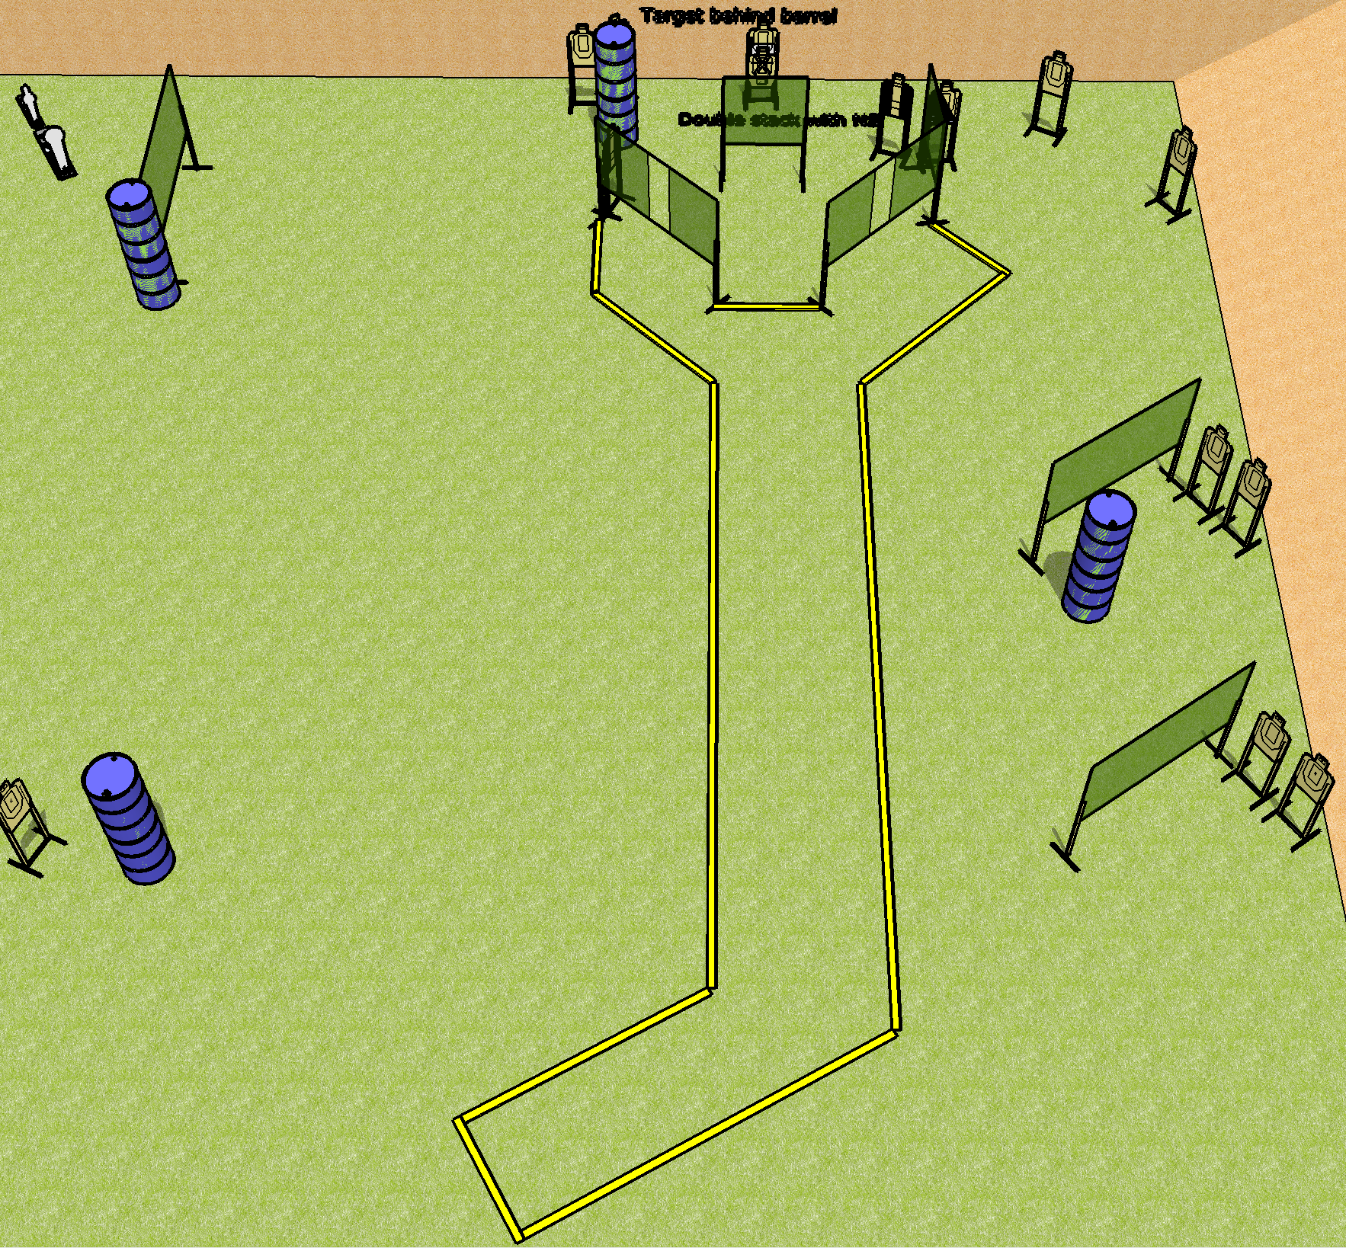
 | Dothan Gun Club – USPSA Match A Day at the Airport Course Designer : Drew Coleman
Round Count 30 rounds 14 USPSA 1 Colt popper, 1 mini popper
Equipment List 14 wall feet 2 tuxedos, 1 diagonal HC

Slide 2
A Day at the Airport
Written Stage Briefing
A Day at the Airport is a 30 round, 150 point, Comstock course of fire. There are 14 USPSA targets, 1 colt popper, and 1 mini popper. The best 2 hits on paper will score. The start signal is audible.
Handgun start position is anywhere inside shooting area, wrists below belt. Handgun is loaded and holstered.
PCC start position is anywhere inside shooting area, stock on belt. Carbine is loaded, safety on.
On start signal, shooter must retrieve the radio off the table next to the Glock 7, which costs more than you make in a month, and retain it during the course of fire. Any shots fired not retaining the radio will be a procedural per shot fired. The radio starts on the mark, on the table.

